Slide 1
Problem Identification
Big Mountain recently installed an additional chair lift to help increase the distribution of visitors, which increased operating costs this season. The business expects recommendations on recouping the increased operating costs in order to maintain profit margin of 9.2% and a projection of this year’s annual revenue based on the recommendations.
This project aims to build a predictive model for ticket price based on a number of facilities, or properties, boasted by resorts (at the resorts). This model will be used to provide guidance for Big Mountain's pricing and future facility investment plans.

Slide 2
Recommendation and key findings
The predicted Adult Weekend ticket price for Big Mountain is $94.22, which is a suggested increase from the current cost of $81.
Our recommendation for either cutting costs or increasing revenue (from ticket prices) is to
Permanently close up to 10 of the least used runs
Increase the vertical drop and install an additional chair lift, without additional snow making coverage.

Slide 3
Data Wrangling & Cleaning
A data error was corrected, and some other rows dropped.
We also obtained some additional US state population and size data with which to augment the dataset, which also required some cleaning.
The data we started with contained some ticket price values, but with a number of missing values that led to several rows being dropped completely.

Slide 4
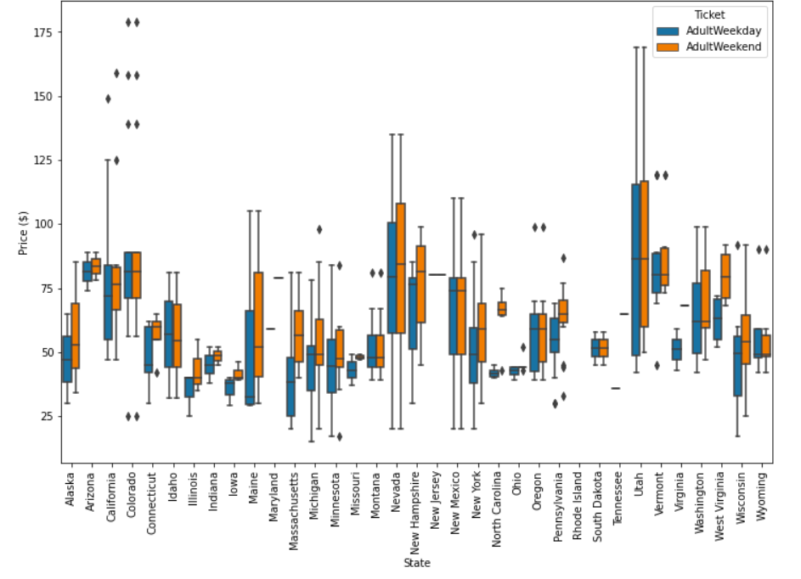
Data Wrangling & Cleaning
There were two kinds of ticket price, weekend and weekday
Most prices are around $25 to over $100 dollars
We decided to drop the ’AdultWeekday’ column
The target feature for our predictive model is the ‘AdultWeekend’ variable

Slide 5
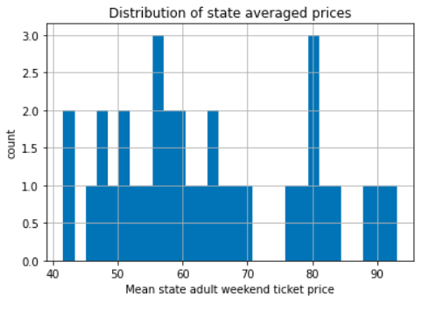
Exploratory Data Analysis
The Average Adult Weekend ticket prices for resorts in each state.

Slide 6
Exploratory Data Analysis
We explored the state summary data and created several new features from the state data.
We merged our state summary features into the ski resort data and added "state resort competition” features.
We created a correlation heatmap hoping to identify patterns amongst the features.
Scatterplots revealed a strong positive correlation with: ’vertical_drop’, ’fastQuads’, ’Runs’, ’total_chairs’ and ’resorts_per_100kcapita’.

Slide 7
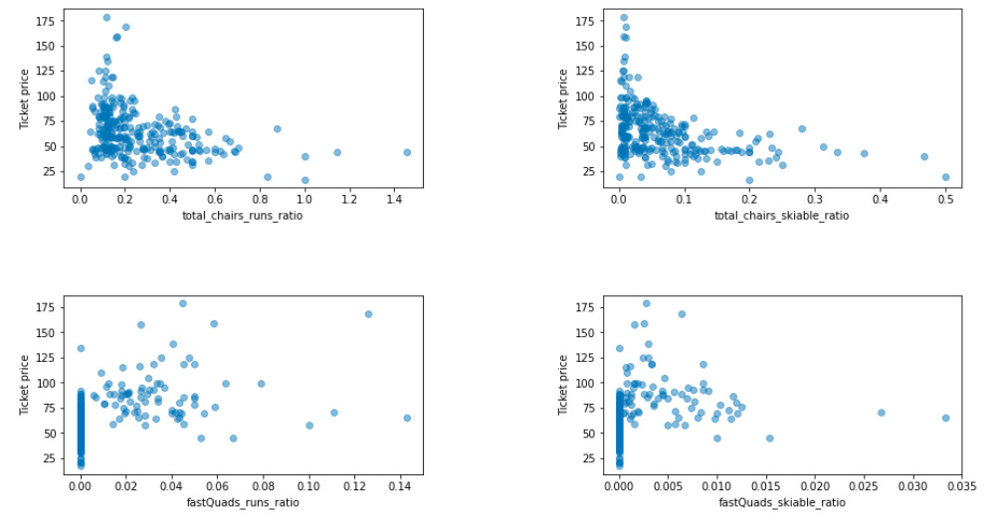
Exploratory Data Analysis
Below are further features that may be useful in that they relate to how easily a resort can transport people around.

Slide 8
Pre-Processing and Training Data
We checked to see how good the mean is as a predictor and as expected, using the average value as our prediction gives us and R2 of zero on our training set.
The linear regression model explains over 80% of the variance on the train set and over 70% on the test set.
The dominant top four features for the linear and the random forest models are: ’fastQuads’, ’Runs’, ’Snow Making_ac’ and ’vertical_drop’.
The random forest model has a lower cross-validation mean absolute error by almost $1, it the model to use going forward.

Slide 9
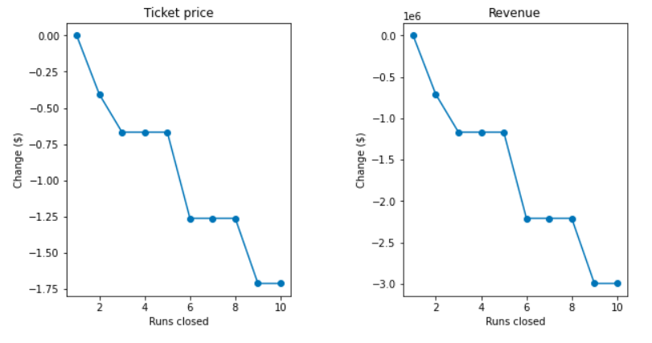
Modeling results and analysis:
Big Mountain currently charges $81.00 for the Adult Weekend ticket price, but the Resort's modelled price is $94.22, which is higher than the actual price.
We reviewed several potential scenarios for either cutting costs or increasing revenue (from ticket prices):
Permanently closing up to 10 of the least used runs.
Increase the vertical drop, which requires the installation of an additional chair lift, without additional snow making coverage.
Same as #2 but adding two acres of snow making cover.
Increase the longest run.

Slide 10
Summary and conclusion
Our model could be lacking some key data, which could attest the higher modeled price or Big Mountain could just be undercharging.
If Big Mountain is undercharging, we suggest you increase the ticket price which is supported in the marketplace.
You should test scenarios 1 and 2:
Permanently close up to 10 of the least used runs
Increase the vertical drop and install an additional chair lift
Maintenance costs might be a useful parameter to also investigate.

